Slide 1



Careflow Vision
01

Slide 2



Write the Problem Statement
Healthtech: Follow-Up Reminder
System Problem
Clinics and private doctors often miss patient follow-ups due to manual tracking, leading to poor care and lost revenue. There's a need for an automated reminder system to keep both patients and providers on schedule.
10

Slide 3

Write Your Solution
CareFlow Vision is an automated reminder system that sends follow-ups via SMS, WhatsApp, and email to reduce missed appointments, improve care, and boost efficiency. It offers a free tier, seamless integration, and HIPAA compliance.
06

Slide 4
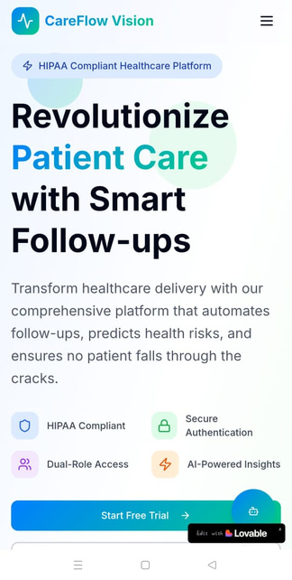
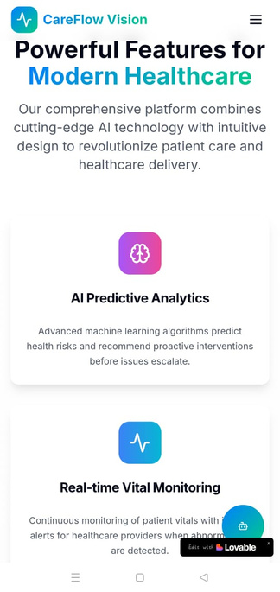
Product
HealthTech SaaS platform
Automates follow-up reminders via SMS, WhatsApp & email
Role-based logins for doctors and patients
Tracks appointments
Mpesa integration for payments
Free tier for small practices
HIPAA compliant
04

Slide 5



Target Market
4 out of 5
Out of 5 patients it is reporte that 4 patients can forget to check their hospital appointments or even go back for review and consultation.
80%
Over 80% of clinics in Nairobi report difficulties managing patient follow-ups, often due to manual systems. This leads to missed care, inefficiencies, and reduced patient satisfaction.
123 million
Over 123 million appointments are missed globally each year. In Nairobi, limited data and manual systems point to widespread no-shows, impacting healthcare quality and clinic efficiency significantly.
14

Slide 6
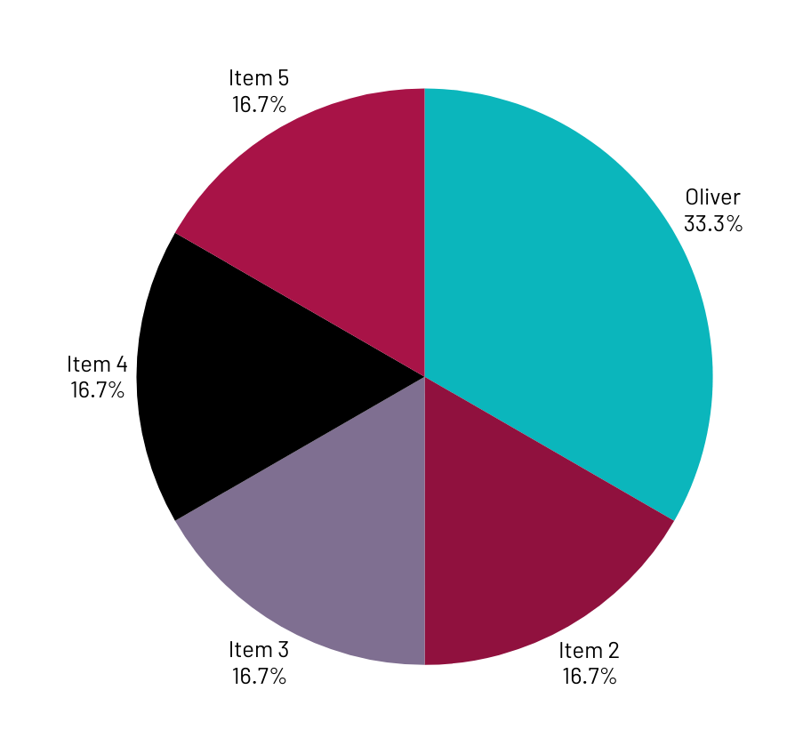
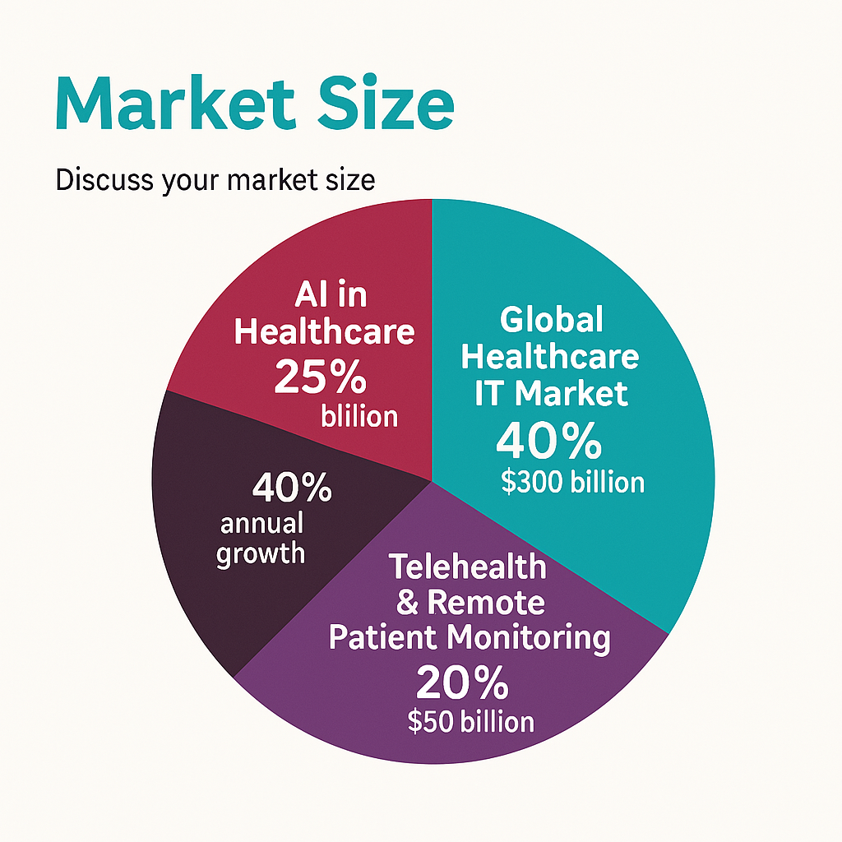
Market Size
Discuss Your market zize
Global Healthcare IT – $300B by 2028, including Eelectronic health records, telemedicine, and AI diagnostics.
Telehealth & Remote Monitoring – $50B market fueled by virtual consultations and home care.
AI in Healthcare – Growing 40% annually, projected at $200B by 2030 for automation & analytics.
Medical Workflow Optimization – Key part of the $100B digital health sector, enhancing efficiency.

Slide 7

Competitors
Key Competitors
Zuri Health - Offers telemedicine and digital health services with basic patient communication features. CareFlow Vision provides more sophisticated AI-driven follow-up automation and predictive analytics.
MyDawa - Kenya's leading online pharmacy with medication delivery and basic health reminders. CareFlow Vision goes beyond medication reminders to comprehensive care coordination and outcome tracking.
23

Slide 8

Competitive Advantage
Automated Patient Engagement - The system likely automates routine follow-up communications, reducing manual workload for healthcare staff while ensuring consistent patient contact after appointments, procedures, or discharge.
Clinical Decision Support - AI analysis of follow-up responses can flag concerning symptoms or changes, alerting healthcare providers to patients who need immediate attention.

Slide 9
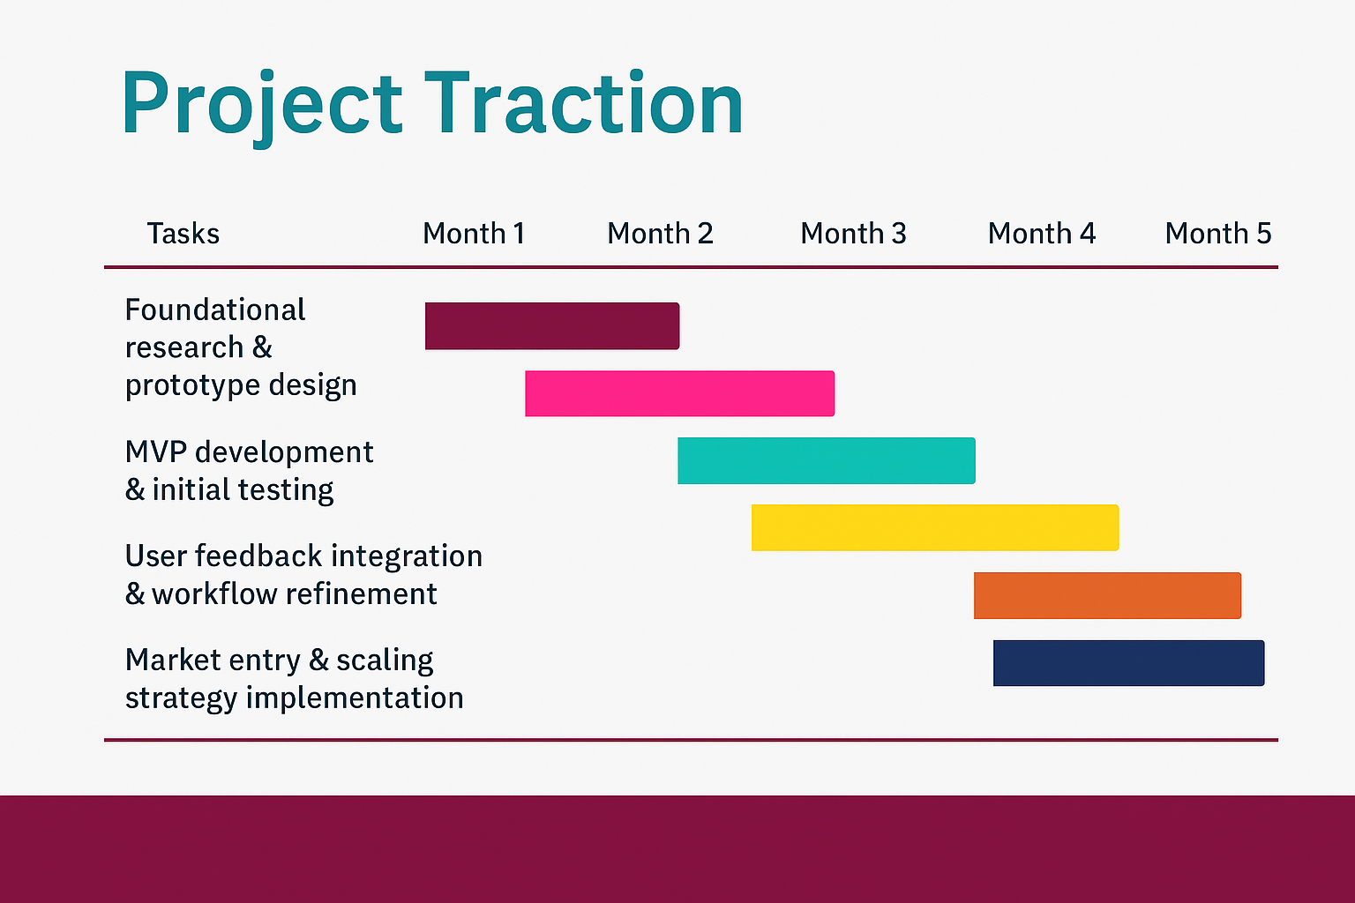
23

Slide 10

Business Model
Care Flow Vision thrives on a tiered subscription model, starting at KES 2,000 for clinics and providers. Premium plans unlock advanced features, custom integrations, and training, driving additional revenue. With a scalable SaaS infrastructure, we maintain 65–70% profit margins, ensuring sustainable growth and affordability. A smart, efficient, and financially viable health tech solution! 🚀
23

Slide 11

Go To Market
Care Flow Vision will reach customers through direct sales, targeted digital marketing, and partnerships with healthcare organizations and telecoms. We’ll offer a free tier and trial periods to encourage adoption, supported by strong customer onboarding and support. Participation in local healthcare events will boost brand awareness and credibility.

Slide 12
Social Impact
What SDGs is your solution addressing, write in point form
SDG 3: Good Health and Well-being – Enhancing healthcare accessibility, patient monitoring, and AI-driven diagnostics.
SDG 9: Industry, Innovation, and Infrastructure – Leveraging digital health technology to improve medical workflows and efficiency.
SDG 10: Reduced Inequalities – Expanding healthcare services to underserved populations and improving access to quality care.
SDG 17: Partnerships for the Goals – Encouraging collaboration between healthcare providers, tech innovators, and policymakers for better patient outcomes.

Slide 13
Our Ask
We’re raising $5K to:
Onboard 20 clinics
Finalize integrations (e.g. SMS, analytics)
Expand the team
Launch a mobile-first version

Slide 14
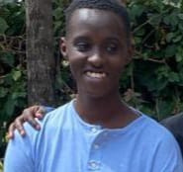
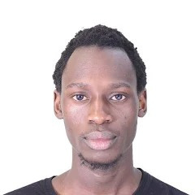
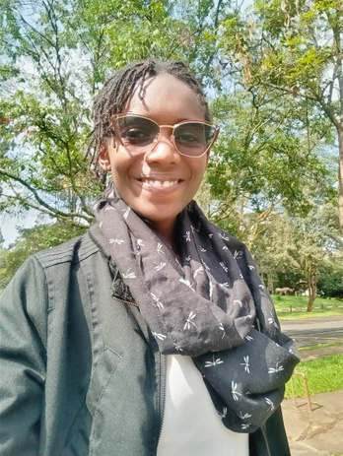

Team Members
Add team members Names and tiles
WARREN
NDEGWA
BARACK OUMA
STACE KERIGA
OLIVER AKWANA
Full Stack Developer
Developer Associate
Marketing Manager.
IT Expert

Slide 15




Thank you!
Contact us at:
https://www.linkedin.com/in/careflow-vision-aa1287368/
Email
THINWARWARREN@GMAIL.COM
17

